Slide 1

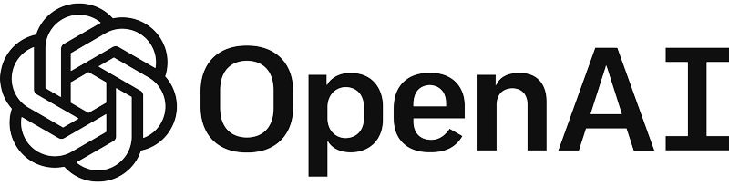
Build a PDF Q&A chatbot using Azure OpenAI and Streamlit

Slide 2
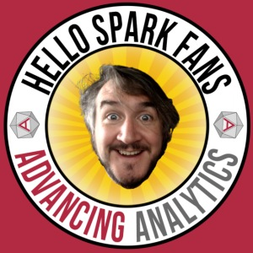










Gavita Regunath
Head of AI
www.advancinganalytics.co.uk
/AdvancingAnalytics
@AdvAnalyticsUK
totallyskewed.co.uk

Slide 3
Prerequisites
VSCode
Python
Azure OpenAI

Slide 4
Why Choose Streamlit for LLM Apps?
Interactivity by Default: Streamlit is a faster way to build interactive data apps. It’s also a lot of fun!
Ease of Use: It's simple, yet powerful, open source Python library enables developers and data scientists to easily create and share beautiful, custom web apps.
Deployment and Sharing: Streamlit has rapidly become the visual UI of choice for LLM-powered apps, including chatbots, sentiment analysis tools, content summarizers, and more.

Slide 5


Q&A chatbot
Azure OpenAI Service
Questions
?
Embedded question
text-embeddings- ada-002
User
Application
Azure AI Services
Section 1
Embedding 1
Vector
search
Azure OpenAI Service
Section 2
Embedding 2
Section 3
Embedding 3
N-Relevant Sections
text-davinci-003
Document Library
VectorDB
Section 4
Embedding 4
Azure OpenAI Service
text-embeddings-ada-002

Slide 6
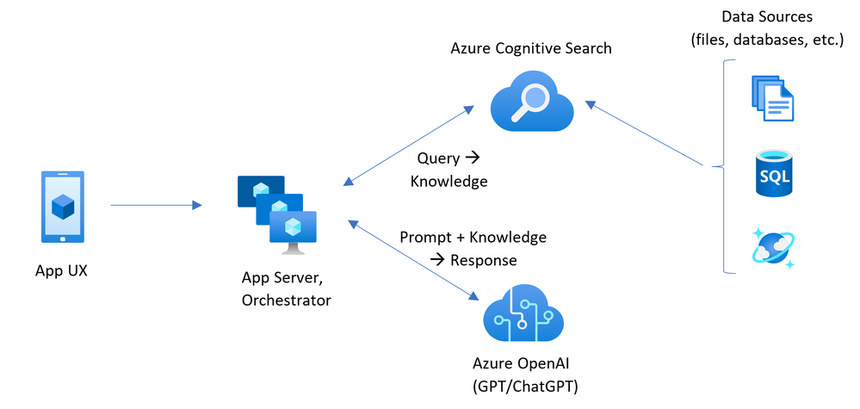
ChatGPT + Enterprise data with Azure OpenAI and Cognitive Search
Official Azure OpenAI Accelerators already exist

Slide 7
Why consider this architecture?
What if you want to run a Retrieval Augmented Generation (RAG) solution locally?
What if the customer wants flexibility in choosing a Vector Databases that is not AI Search?
What is the customer does not want to upload their data for embedding?
What if you want flexibility with chunking documents?

Slide 8
RAG In a Nutshell

Slide 9
Hallucinations
Lack of transparency
Uncontextualised data

Slide 10
Ability of an LLM to learn information not through training, but by receiving new information in a carefully formatted prompt

Slide 11
R A G
1
2
3
Retrieval
Get information from a database that relates to the question you asked.
Augmentation
Combine the retrieved information with the initial prompt
Generate
Pass the augmented prompt to a large language model, generating the final output

Slide 12






RAG Architecture: Using your own industry specific data
I need information about my recent car accident claim. What is the estimated value of the claim?
RAG Model
?
Search
Store
Embeddings
[010101001001]
Semantic search
Embeddings
[010101001001]
User
“Based on our records, the estimated value of your recent car accident claim is £12,500. Please note that this estimate is subject to review by our claims adjuster to ensure accuracy.”
Vector database
Knowledge base
Claim Documents
Prompt injection
Question + Context
Retrieval
{ }
Generate
Augmentation
User

Slide 13

What problem do they solve?
Hallucinations:
RAG mitigates hallucinations by retrieving data from trusted sources, ensuring responses are grounded in factual information.
Lack of Transparency:
RAG offers transparency through retrieval, indicating the source of information, improving traceability, and identifying knowledge base issues or biases.
Contextual Understanding:
RAG enhances context by combining retrieval with generation from a knowledge base, resulting in more contextually relevant and accurate answers.

Slide 14
Real world examples with RAG

